Slide 1

Predicting Grade Level of Educational Resources
Presented By
Dimpi Saikia 15CS60R08
Gowtham Nayak 15CS60R22
Kalyani Roy 15CS60R20
Survi Makharia 15CS60R01
Under the Guidance
of
Dr. Plaban Bhowmick

Slide 2
Contents
Introduction
Framework
Feature Selection
Training
Classification
Milestones

Slide 3
Introduction
We want to target people of all grade labels, so we need to show them the relevant documents that they can understand.
To do this, we require an automated document classifier that can classify documents easily.
We are demonstrating an approach to predict the grade labels of documents.
Here we are building a predictive grade label classifier that predicts the probability of belonging of a document to the grades specified in the training.

Slide 4
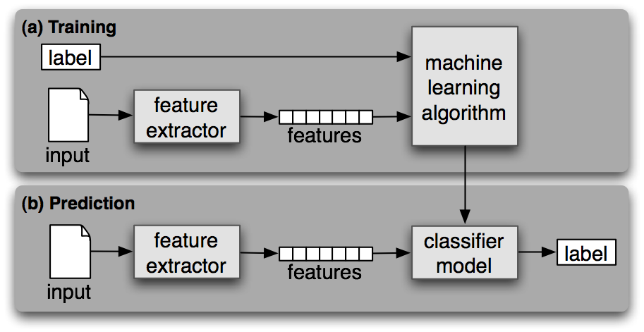
Framework
A supervised training corpora containing the correct label for each input.
In our model we are considering NCERT textbooks of different grades.

Slide 5
Feature Selection
We need to identify features of data that are salient for classifying, till now we have used three different features:
Unigram probability
Average word length
Average sentence length

Slide 6
Training Data
We decided to focus on textbooks that are suggested on reading lists at different grade levels in NCERT.
This gave us the large amount of text we needed for building language models, and additionally, labeled data was readily available.
We have considered data of 6-10 grade labels.

Slide 7
Classification
We are doing probabilistic classification of a document into various grade labels
The classifier that we are using now is logistic regression.
But we will also use Naive Bayes, Random Forest, Support Vector Machine and then compare their performance.

Slide 8
Milestones
Different encoding of pdf documents in the training corpus.
For documents that contains words most of which are unseen, prediction is not significantly good.
Some of the words in pdf are not separated by space, which leads to faulty unigrams.

Slide 9
References
Martin, James H., and Daniel Jurafsky. "Speech and language processing."International Edition (2000).
http://www.nltk.org/book_1ed
http://nlp.stanford.edu/courses/cs224n/2008/reports/12.pdf
Language processing in e-learning, lecture slides by dr. plaban Bhowmick

Slide 10
Thank You!

